Slide 1

END SEM PRESENTATION
on
C TO PYTHON COMPILER USING LEX AND YACC
Team Members
B.SAI ABHISHEK BL.EN.U4AIE21015
B.RUCHITH BALAJI BL.EN.U4AIE21017
CHILLAKURU HARI BL.EN.U4AIE21038
Date:15/05/24
Course :IMCD
Meena Belwal Ma’am
AI 6th Sem –E Sec

Slide 2
CONTENTS
Introduction
Problem Statement
Proposed Methodology
Results
Conclusion
References

Slide 3
INTRODUCTION
In this project, we aim to develop a C to Python compiler using Lex and Yacc, two powerful tools for lexical analysis and parsing.
Converting from C to Python can offer several advantages in real-life applications:
Python code is generally more concise and readable compared to C. Python's clean and simple syntax, along with its high-level constructs, can make code easier to understand and maintain, reducing the time and effort.
Converting C code to Python can make the resulting application more platform-independent, reducing compatibility issues and simplifying deployment across different operating systems.

Slide 4
Problem Statement
The problem Statement is to develop a C to Python compiler using Lex and Yacc
The goal is to build a scalable and efficient solution that incorporates advanced techniques to convert the code from C to Python
Challenges:
Grammer Building.
States Identification.
Maintaining Efficiency.
Handling Errors.

Slide 5
Methodology - Overview
Input.C Code: This is the starting point of the methodology. It refers to the input code written in the C programming language.
Lexical Analysis: The lexical analysis stage breaks the code down into tokens, which are the basic units of a program. These tokens can be keywords, identifiers, operators, or literals.
Syntax Analysis: The syntax analysis stage checks the tokens to make sure they follow the grammatical rules of the programming language. This is similar to how a grammar check works for written text.
Semantic Analysis: The semantic analysis stage checks the tokens to make sure they make sense together. For instance, it might check to make sure that variables are used correctly.
Code Generation: The code generation stage translates the tokens from the C program into code in a different language, Python in this case.
Output.py: This is the final stage of the methodology, which results in a Python code file.

Slide 6
Methodology - Parser
LALR Parser: This refers to the specific type of parser used for syntax analysis. LALR stands for "Lookahead LR," which is a type of parser that can handle a wider range of grammars compared to simpler LR parsers.
122 Unique States: The parser has identified 122 unique states during the analysis process. These states represent different points in the parsing process where the parser has encountered a specific sequence of tokens and needs to decide how to proceed. A higher number of states can indicate a more complex grammar or a larger program being analyzed.
22 Shift-Reduce Conflicts: These conflicts arise when the parser encounters a situation where it's unsure whether to perform a "shift" operation (add a new token to the parse stack) or a "reduce" operation (apply a grammar rule and replace a portion of the stack with a non-terminal symbol).

Slide 7
Methodology – Flow Diagram
Tokens.l
Parser.y
Input .C Code
Lexical Analysis
Syntax Analysis
Semantic Analysis
Code Generation
Output.py
Tokens generated line by line
Understands Keyword based on .l and .y
Arrange to avoid Grammatical Mistakes and Parse

Slide 8
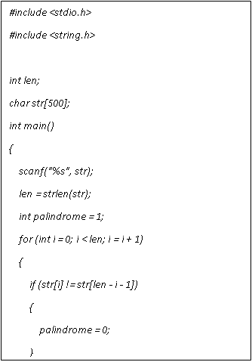
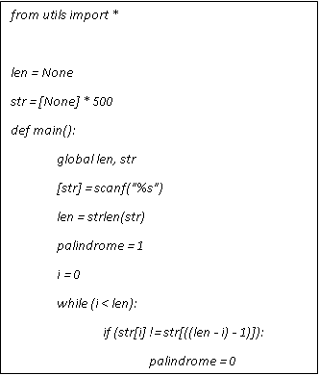
Results – Example:1
Input.c
Out.py

Slide 9
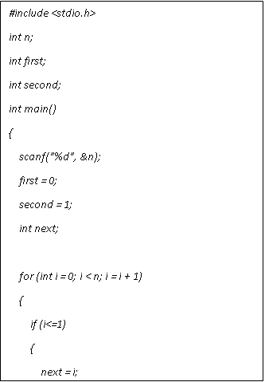
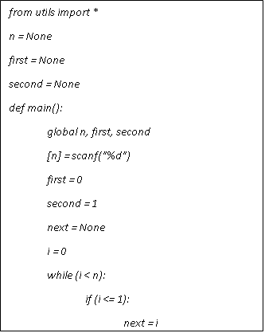
Results – Example:2
Input.c
Out.py

Slide 10
Conclusion
From the observations it is seen that the C to Python translator successfully translates the C code into the Python code which is syntactically correct and functionally equivalent.
The flawless operation of the Python code that was generated without any errors proves that the translation of the C code has not lost the logic and functionality of the original C.
This indicates that the translator could be a useful source for the developers who want to migrate or work with C code in Python environments.

Slide 11
References
Lachaux, Marie-Anne, Baptiste Roziere, Lowik Chanussot, and Guillaume Lample. "Unsupervised translation of programming languages." arXiv preprint arXiv:2006.03511 (2020).
Shi, Freda, Daniel Fried, Marjan Ghazvininejad, Luke Zettlemoyer, and Sida I. Wang. "Natural language to code translation with execution." arXiv preprint arXiv:2204.11454 (2022).
Hariri, Walid. "Unlocking the potential of ChatGPT: A comprehensive exploration of its applications, advantages, limitations, and future directions in natural language processing." arXiv preprint arXiv:2304.02017 (2023).
Likhith, Arlagadda Naga, Kothuru Gurunadh, Vimal Chinthapalli, and Meena Belwal. "Compiler For Mathematical Operations Using English Like Sentences." In 2023 7th International Conference on Computation System and Information Technology for Sustainable Solutions (CSITSS), pp. 1-6. IEEE, 2023.
Pecheti, Shiva Teja, H. M. Basavadeepthi, Nithin Kodurupaka, and Meena Belwal. "Recursive Descent Parser for Abstract Syntax Tree Visualization of Mathematical Expressions." In 2023 7th International Conference on Computation System and Information Technology for Sustainable Solutions (CSITSS), pp. 1-6. IEEE, 2023.

